Slide 2
Navigating the Road Ahead: AI Applications in the Limo Industry
Speaker:
Thomas “TJ” Wilform
SimpleTech Solutions
AV Sponsor
Coffee Sponsor

Slide 3
Welcome & Thank You to Our Sponsors
AV Sponsor
Coffee Sponsors

Slide 4
Welcome to the AI Revolution
Goals for this session:
Demystify AI
Explore practical applications in your day-to-day operations
Get you on the road to integrating AI into your business
AV Sponsor

Slide 5
AI in Daily Life:
AI Is All Around Us
AI is a part of our everyday lives without us even realizing it.
We use AI every day in our smartphones, apps, and online services.
Examples include Siri, Alexa, Google Maps, Netflix recommendations, and spam filters.
AI can simplify tasks, personalize experiences, and improve efficiency in the limo industry.
AV Sponsor

Slide 6
Driving Efficiency with AI
Microsoft Copilot can analyze your data, automate tasks, and generate insightful reports.
AI can optimize your fleet by tracking vehicles, scheduling maintenance, and analyzing fuel consumption.
AI can also predict potential vehicle issues before they arise, saving you time and money.
AI can optimize routes to ensure faster trips and lower fuel costs.
Dynamic pricing, powered by AI, can help you adjust rates based on demand and maximize revenue.
AV Sponsor

Slide 7
The AI-Driven Customer Experience
AI-powered chatbots can provide instant support to your customers 24/7.
Chatbots can answer questions, book reservations, and handle common requests.
AI can personalize customer interactions by providing tailored recommendations and proactive communication.
AI can automate follow-up messages and send reminders to enhance customer satisfaction.
By using AI, you can improve customer loyalty and encourage repeat business.
AV Sponsor

Slide 8
Streamlining Operations:
AI – Your Automation Ally
Automate repetitive tasks such as generating reports, drafting emails, and processing invoices.
Automation increases productivity, reduces errors, and frees up your staff for more important tasks.
Streamline communication and improve collaboration within your company.
AV Sponsor

Slide 9
Marketing + Finance:
Data-Driven Decisions with AI
Analyze marketing data to identify trends, customer preferences, and the most effective marketing channels.
Help you create targeted campaigns, personalize messages, and optimize your budget.
Help you forecast demand, optimize pricing strategies, and identify cost-saving opportunities.
Automate financial reports and provide valuable insights for better decision-making.
Improve employee engagement through personalized training and performance feedback.
AV Sponsor

Slide 10
AI-Driven Productivity Assistants
AI-powered assistants can handle tasks like scheduling appointments, booking travel, and managing emails.
These tools can free up your time so you can focus on building client relationships and developing new business opportunities.
AI assistants can be personalized to learn your preferences and anticipate your needs.
AV Sponsor

Slide 11
AI in Action:
Real-World Transformations
AI to optimize their dispatch system, leading to a 15% increase in efficiency and a 10% reduction in fuel costs.
Implemented an AI chatbot to handle customer inquiries, resulting in a 20% increase in customer satisfaction and a 5% increase in bookings.
These case studies highlight the real-world benefits of AI in the limo industry.
Learn from these successes and discover how AI can transform your business.
AV Sponsor

Slide 12
Getting Started with AI
Start with a small, manageable AI project and gradually scale up as you gain experience.
Identify areas where AI can make the biggest impact on your business, such as customer service or dispatch.
Choose AI tools that integrate with your existing systems and are easy for your team to use.
Experiment with different AI solutions to find the best fit for your needs.
AV Sponsor

Slide 13
The Road Ahead:
AI + the Future of Mobility
AI is driving exciting new developments in transportation, including intelligent logistics and autonomous vehicles.
In the future, AI will likely play a major role in the limo industry, enabling personalized routes, optimized fleet management, and enhanced safety features.
Stay informed about the latest AI trends and adapt your business to thrive in the future of transportation.
AV Sponsor

Slide 14
Q&A
Now is your chance to ask questions about AI and how it can benefit your limo business.
Let's discuss your concerns and explore the opportunities that AI presents.
AV Sponsor

Slide 15
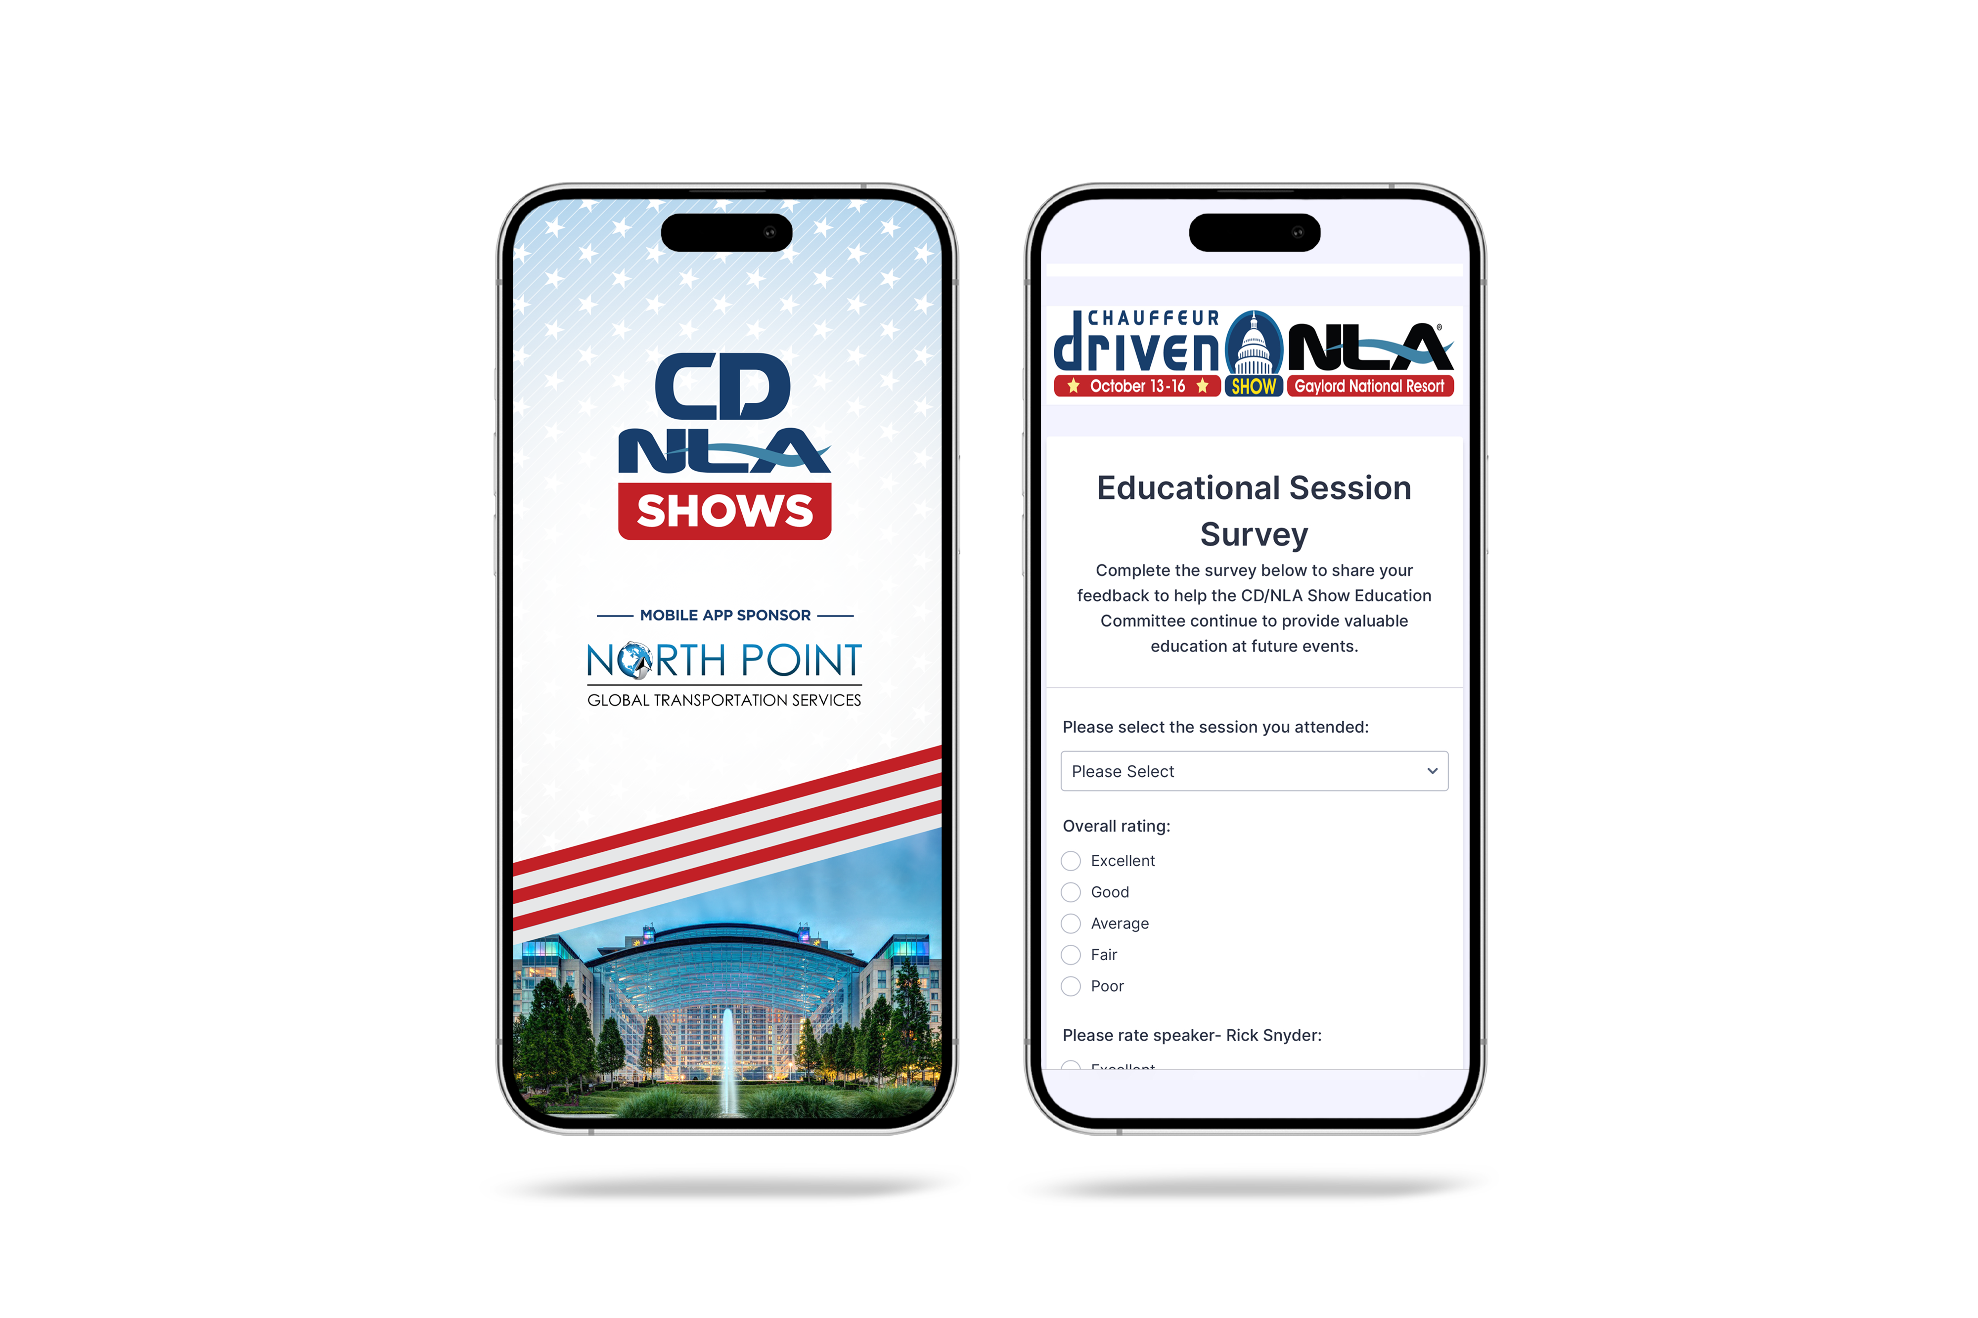
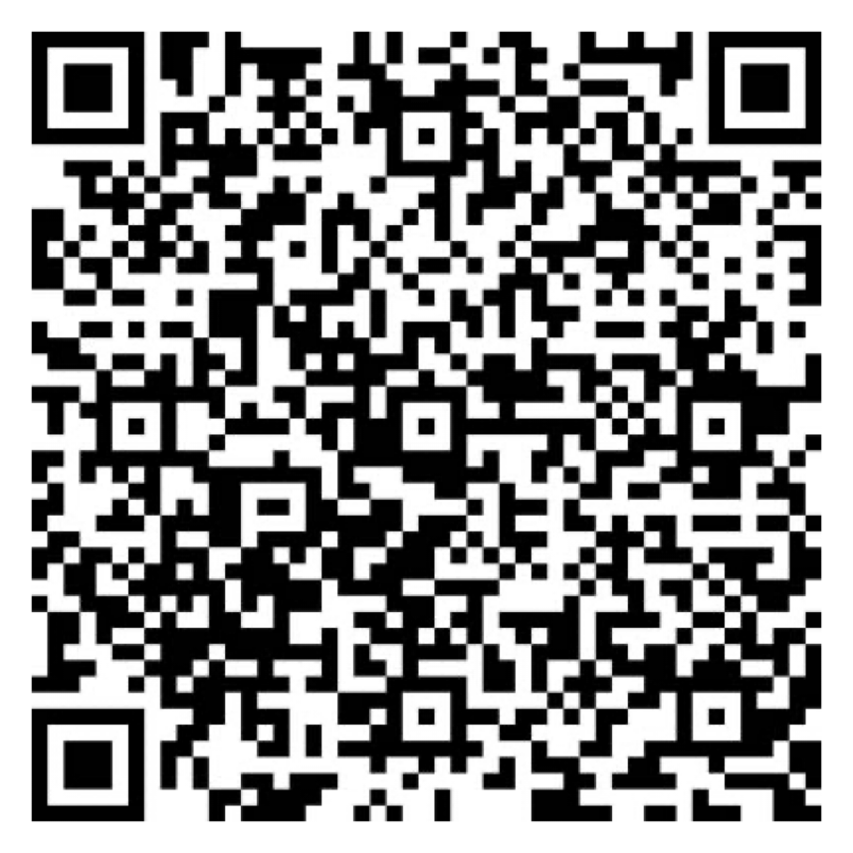
Let Us Know How
We Did!
Fill Out the Survey
AV Sponsor
Coffee Sponsor

Slide 16
Thank You for Joining Us!
AV Sponsor
Coffee Sponsor

